Slide 1
NAME : Yogesh Patil
Subject : Foss

Slide 2
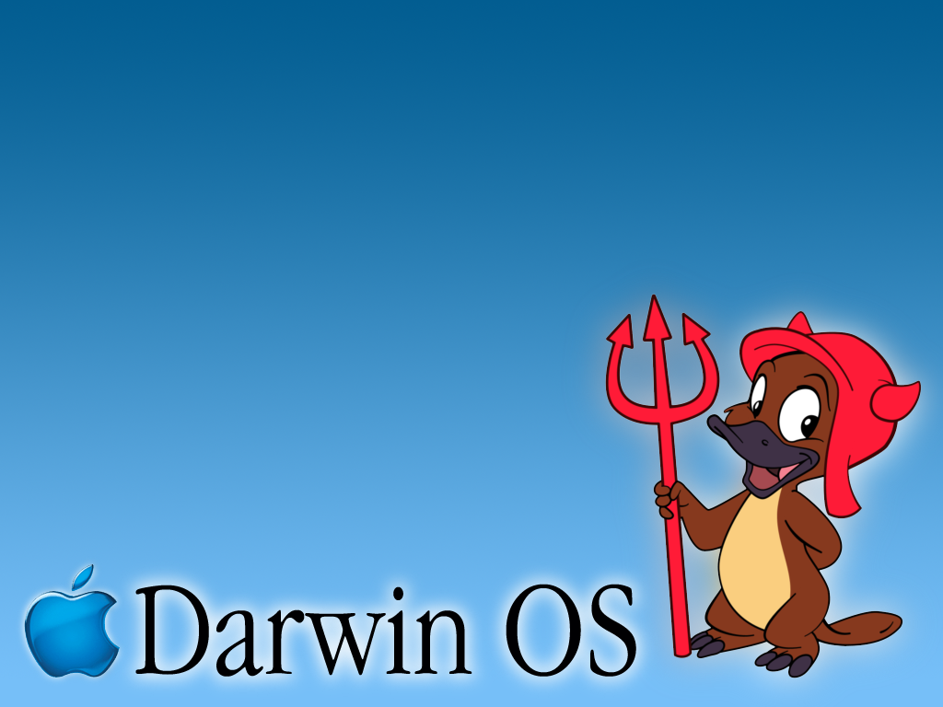
TOPIC :

Slide 3


Slide 4
INTRODUCTION

Slide 5
Interface Of Darwin OS

Slide 6
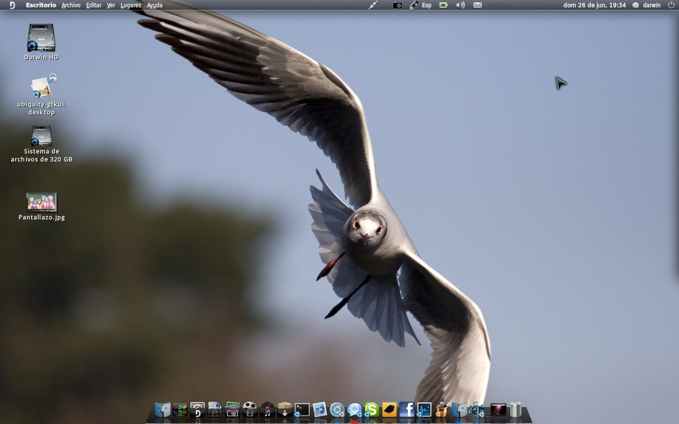

Slide 7
Advantages:
Integrated system.
Backward Compatibility
Enhanced Performance and Stability.
Disadvantages:
Software compatibility shortcomings and support.
Security: Darwin is distributed under Open Source license, security threat.
Classic applications run and load slowly.
Marketing weakness and media coverage.

Slide 8
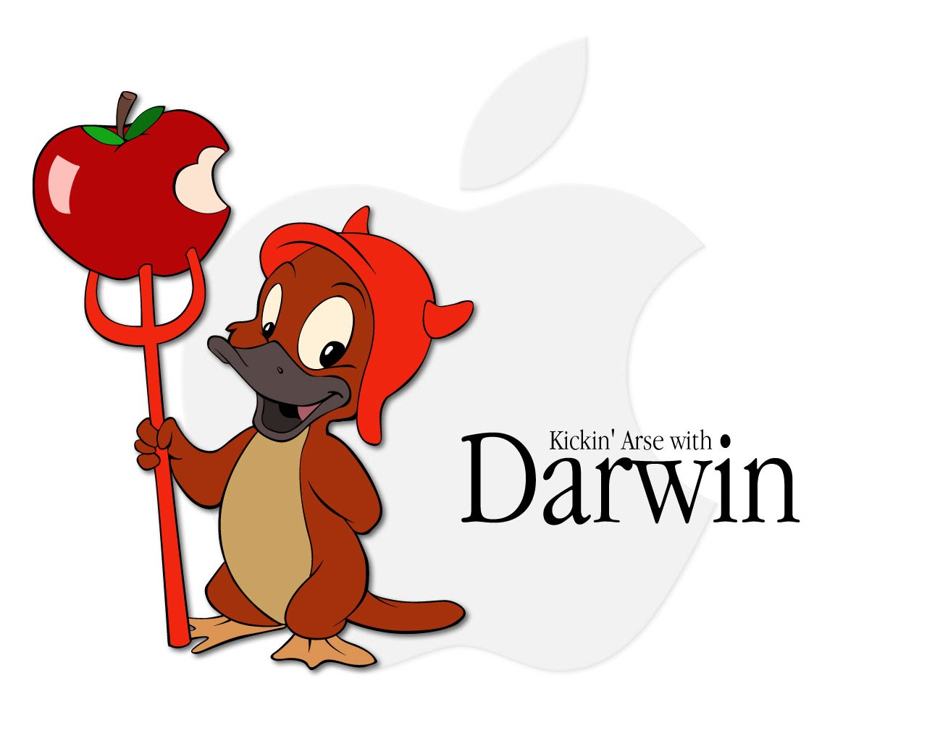
Open Darwin

Slide 9
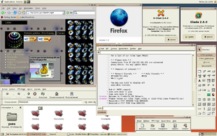

Slide 10
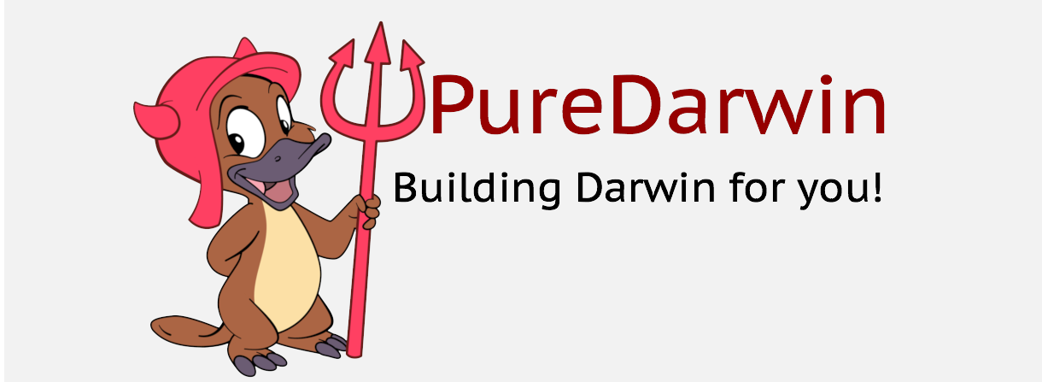

Slide 11
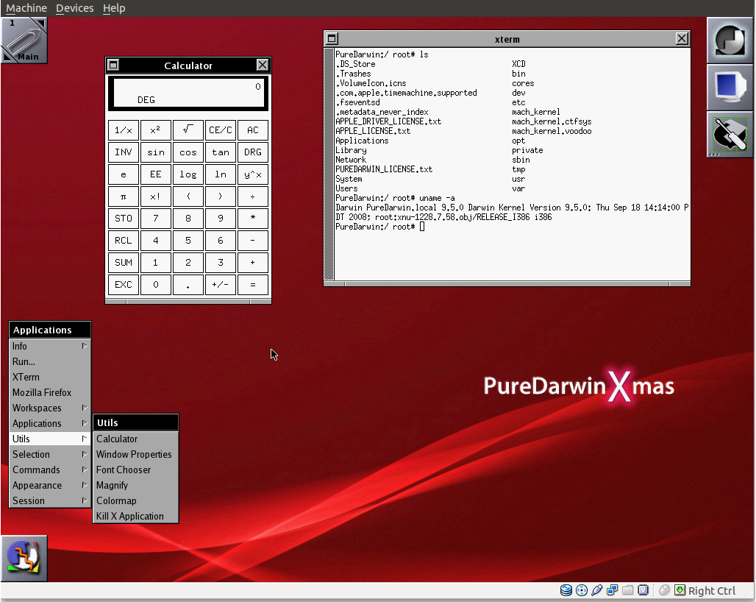

Slide 12
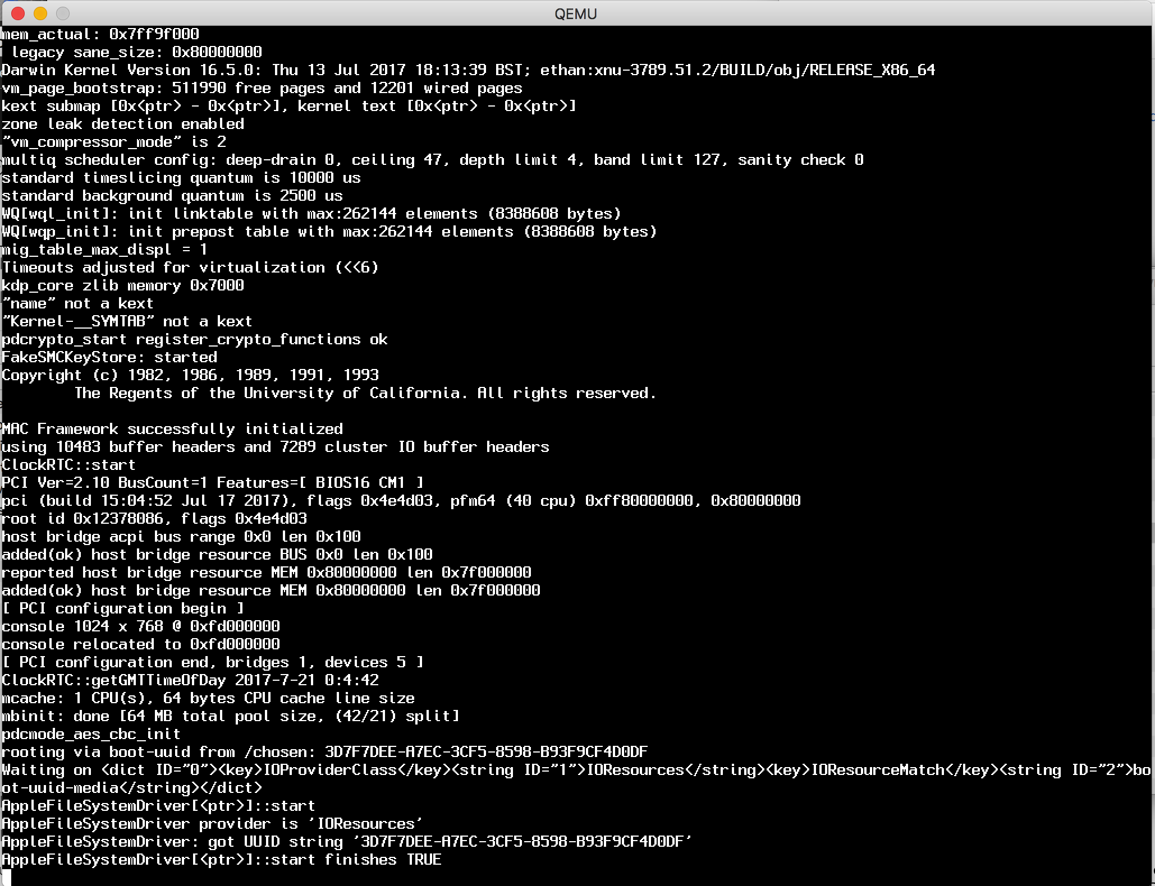
Latest Build

Slide 13
Darwin has had a very bright past, and its future is increasingly bright. Many universities use Darwin for educational purposes to teach operating system design.
CONCLUSION

Slide 14
THANK YOU

